Slide 1

Smart On-Street Parking
Made by:
Vladut PANAITE 1111154
Adrien COSTANDI 1110995

Slide 2
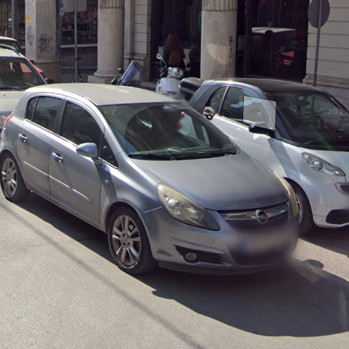
Problems
Traffic Congestion
Road obstructions
Limited space for parking
High costs for hiring officers to maintain order in street patrols
Difficulties finding parking spots
Blocked facilities like garages, hydrants, crosswalks etc.

Slide 3

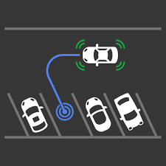
Our Solutions
Using google API to detect crowded areas to deploy our system more efficiently
Detect illegal on street parking
Manage law enforcers efficiently by setting priorities for illegal parking
Proposing available parking spots
Use Google Api to evaluate if a particular illegal parking is currently affecting the traffic

Slide 4

Unique Value Proposition
We can estimate the impact of illegal on street parking using google API in order to check the traffic and focus resources in those areas.
Ability to create a heatmap to identify the most sensitive places and help taking decisions
Decisions can be about city planning, sending the police, finding available parking spots

Slide 5
SWOT – Analysis
Strengths
The help of good technologies with AI
Good network infrastructure
Weaknesses
(security ,privacy, anonymity)
Implementation scale
Opportunities
Lack of parking spots
Need of better traffic management
Threats
Disagreement from the citizens
(security ,privacy, anonymity)
Optimized, Lightweight, Intuitive User Interface
Reliability of the system
Increases in incomes from fines generated by illegal parking
Maintenance of the hardware
Expensive hardware

Slide 6

Stakeholders :
Cities / Municipalities
Traffic law enforcements
Citizens
Public Administration
Parking management companies

Slide 7
COSTS (estimated for a portion of Korinthou Street)
Hardware
17pcs parking sensor S-LG3T: ~ 200 Euros/pcs
1pcs IMOU CRUISER CAMERA SE ~ 74 Euros/pcs
1pcs Raspberry Pi Model B+ ~50 Euros/pcs
3 x ER14505 AA 3.6V~ 3 Euros/pcs
Others
Maintenance ~ 15 +(replacements) Euros (when requested or once per year)
*Notes: City will provide access to internet and electricity

Slide 8
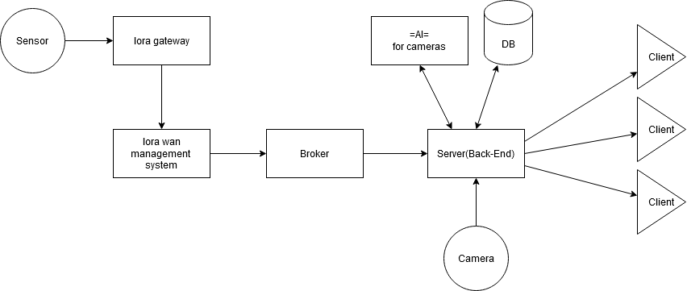
ARCHITECURE

Slide 9



COMPETITORS
Doesn’t include detection for illegal parking on street
Doesn’t inform law enforcers about illegal parking
Only works with bus lanes
Notes:
Intercomp Already has some implementation here in Patras around the port
Amco Focused promotes public transport
* SEPTA The cameras are placed on buses and when the bus lane is blocked it sends an alert

Slide 10
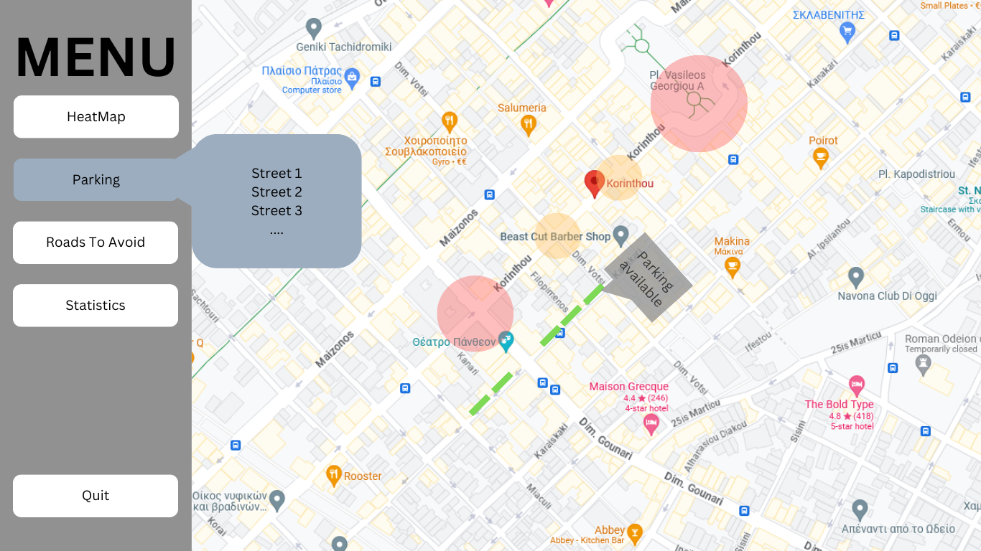
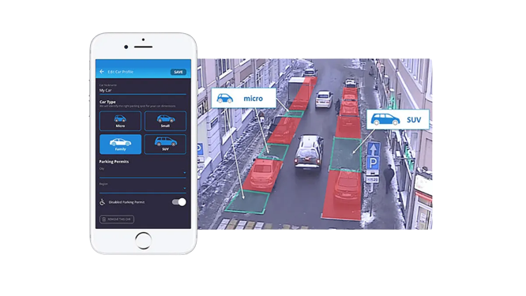
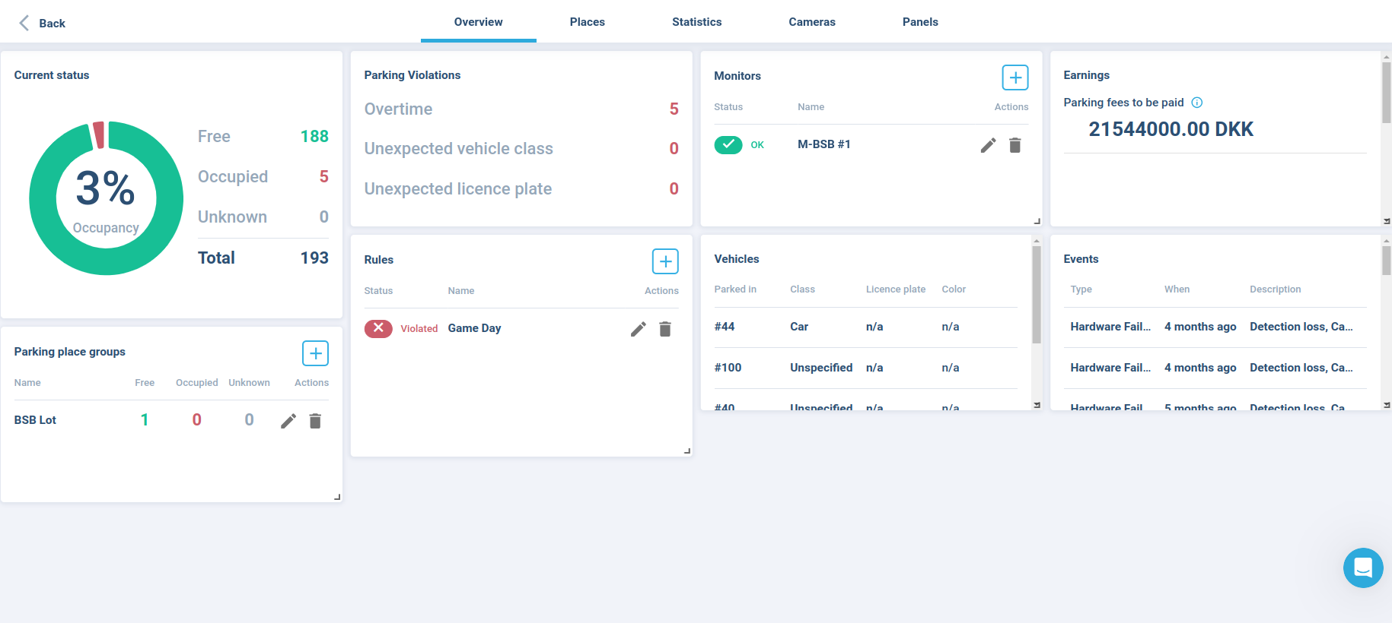
Application Demo

